Slide 1
depan
depan
0
0
0
-20
Youtube pergerakan robot 4 kaki
https://www.youtube.com/watch?v=kP2yS0RHLXA
0
0
-20
0
0
depan
40
-20
depan
0
40
depan
0
0
depan
-20
-20
30
-20
-20
30
-20
-20
-20
MajuKanan
MajuKananDorong
MajuKiri
MajuKiriDorong
dorong
Arah Tujuan
angkat

Slide 2
depan
depan
0
0
-30
0
Youtube pergerakan robot 4 kaki
https://www.youtube.com/watch?v=kP2yS0RHLXA
0
0
0
-30
40
depan
0
0
depan
-20
0
depan
40
-20
depan
0
30
-20
-20
-20
-20
30
-20
-20
MajuKiri
MajuKiriDorong
MajuKanan
MajuKananDorong
dorong
Arah Tujuan
angkat

Slide 3
-35 :T
50 :M
-50 :B
depan
T: -35
M: 50
B: -50
depan
0
-20
Youtube pergerakan robot 4 kaki naik permukaan dengan menjatuhkan badan
https://www.youtube.com/watch?v=SWm5f2z0Wj4
-35 :T
50 :M
-50 :B
T: -35
M: 50
B: -50
-20
0
0
depan
40
-20
depan
0
40
depan
0
0
depan
-20
-20
30
-20
-20
30
-20
-20
-20
MajuKanan
MajuKananDorong
MajuKiri
MajuKiriDorong
dorong
Arah Tujuan
angkat

Slide 4
0
0
-20
0
-20
0
-20
0
0
0
0
0
-20
0
-20
20
-20
20
0
20
0
0
-20
20
0
20
0
0
dorong
angkat

Slide 5
compass.setCalibration(-891, 1147, -1741, 433, -177, 250);
198
170
230
253 = min south
148
257
Keluar Home ➔
260 = max south
100
300
x<100, x>300

Slide 6
compass.setCalibration(0, 3072, -938, 743, -268, 133);
250
90
?
300 = min south
70(65~75)
305
Keluar Home ➔
311 = max south
50
335
14

Slide 7
compass.setCalibration(0, 3072, -938, 743, -268, 133);
compass.setCalibration(-891, 1147, -1741, 433, -177, 250);
250
198
90
?
170
230
300 = min south
253 = min south
70(65~75)
305
Keluar Home ➔
148
257
Keluar Home ➔
311 = max south
260 = max south
50
335
100
300
14
x<100, x>300

Slide 8
Berdiri Permukaan Datar
Berdiri Permukaan Menaik
(-35, 43)
(-35, 43)
(-35, 43)
(-35, 43)
(-51, 44)
LFT 0
RFT 0
(-41, 54)
LFT 0
RFT 0
LFB 0
RFB 0
(-51, 44)
LFB -10
RFB -10
(-41, 54)
LFM 0
RFM 0
LFM 10
RFM 10
(-28, 50)
(-28, 50)
(-38, 40)
(-38, 40)
(-40, 32)
(-40, 32)
(-40, 32)
(-40, 32)
(-51, 44)
LBT 0
RBT 0
(-79, 16)
LBT 0
RBT 0
LBB 0
RBB 0
(-51, 44)
LBB 28
RBB 28
(-79, 16)
LBM 0
(-28, 50)
RBM 0
LBM -28
(0, 78)
RBM -28
(-28, 50)
(0, 78)

Slide 9
Berdiri Permukaan Datar
Berdiri Mundur Permukaan Menaik
(-35, 43)
(-35, 43)
(-35, 43)
(-35, 43)
LFT 0
RFT 0
LFT 0
RFT 0
(-51, 44)
(-51, 44)
(-79, 16)
(-79, 16)
LFB 0
RFB 0
LFB 28
RFB 28
LFM 0
RFM 0
LFM -28
RFM -28
(-28, 50)
(-28, 50)
(0, 78)
(0, 78)
(-40, 32)
(-40, 32)
(-40, 32)
(-40, 32)
LBT 0
RBT 0
LBT 0
RBT 0
(-51, 44)
(-51, 44)
(-41, 54)
(-41, 54)
LBB 0
RBB 0
LBB -10
RBB -10
LBM 0
(-28, 50)
RBM 0
LBM 10
(-38, 40)
RBM 10
(-28, 50)
(-38, 40)

Slide 10
0
0
0
20
0
depan
0
20
depan
0
0
-30
20
0
-30
0
0
20
20
depan
-20
20
depan
20
-20
depan
20
20
depan
20
MundurKiri
MundurKiriDorong
MundurKanan
MundurKananDorong
dorong
Arah Tujuan
angkat

Slide 11
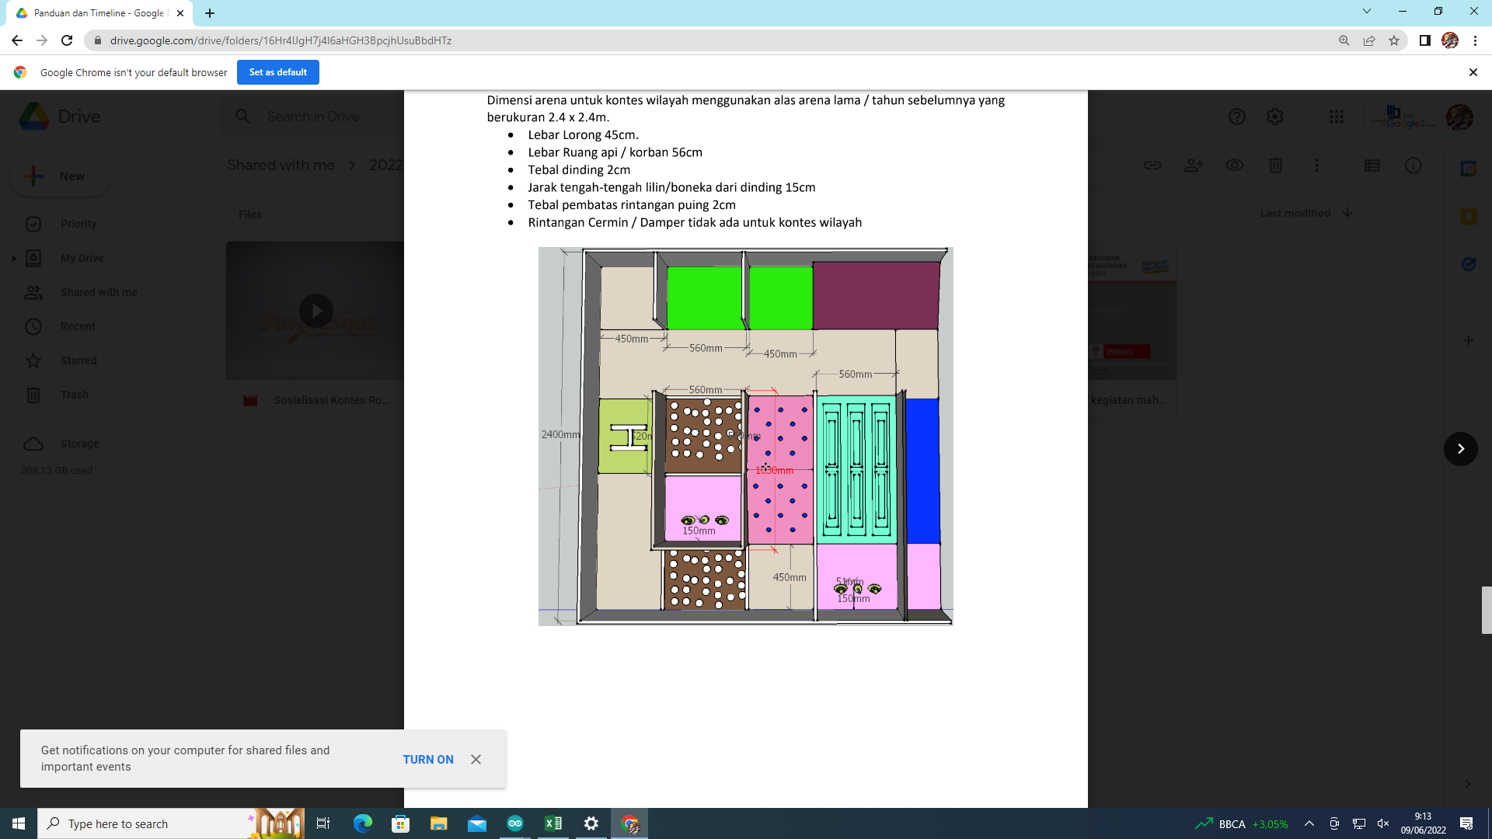
268-282
S
210-230
E
W
350-25
N
115-100

